Slide 1
CHAPTER 5
Probability: Review of Basic Concepts
to accompany
Introduction to Business Statistics
seventh edition, by Ronald M. Weiers
Presentation by Priscilla Chaffe-Stengel
Donald N. Stengel
© 2011 Cengage Learning.
All Rights Reserved. May not be scanned, copied, or duplicated, or posted to a publicly accessible website, in whole or in part.

Slide 2
Chapter 5 - Learning Objectives
Construct and interpret a contingency table
  Frequencies, relative frequencies & cumulative relative frequencies.
Determine the probability of an event.
Construct and interpret a probability tree with sequential events.
Use Bayes’ Theorem to revise a probability.
Determine the number of combinations or permutations of n objects r at a time.
        © 2011 Cengage Learning.
        All Rights Reserved. May not be scanned, copied, duplicated, or posted to a publicly accessible website, in whole or in part.

Slide 3
Chapter 5 - Key Terms
Experiment
Sample space
Event
Probability
Odds
Contingency table
Venn diagram
Union of events
Intersection of events
Complement
Mutually exclusive events
Exhaustive events
Marginal probability
Joint probability
Conditional probability
Independent events
Tree diagram
Counting
Permutations
Combinations
        © 2011 Cengage Learning.
        All Rights Reserved. May not be scanned, copied, duplicated, or posted to a publicly accessible website, in whole or in part.

Slide 4
Chapter 5 - Key Concepts
The probability of a single event falls between 0 and 1.
The probability of the complement of event A, written A’, is
P(A’) = 1 – P(A)
The law of large numbers: Over a large number of trials, the relative frequency with which an event occurs will approach the probability of its occurrence for a single trial.
        © 2011 Cengage Learning.
        All Rights Reserved. May not be scanned, copied, duplicated, or posted to a publicly accessible website, in whole or in part.

Slide 5
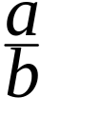
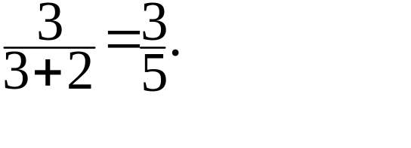
Chapter 5 - Key Concepts
Odds vs. probability
If the probability event A occurs is , then the odds in favor of event A occurring are a to b – a.
  Example: If the probability it will rain tomorrow is 20%, then the odds it will rain are 20 to (100 – 20), or 20 to 80, or 1 to 4.
  Example: If the odds an event will occur are 3 to 2, the probability it will occur is
        © 2011 Cengage Learning.
        All Rights Reserved. May not be scanned, copied, duplicated, or posted to a publicly accessible website, in whole or in part.

Slide 6

Chapter 5 - Key Concepts
Mutually exclusive events
  Events A and B are
  mutually exclusive if both cannot occur at the same time, that is, if their intersection is empty. In a Venn diagram, mutually exclusive events are usually shown as nonintersecting areas. If intersecting areas are shown, the intersections are empty.
        © 2011 Cengage Learning.
        All Rights Reserved. May not be scanned, copied, duplicated, or posted to a publicly accessible website, in whole or in part.

Slide 7
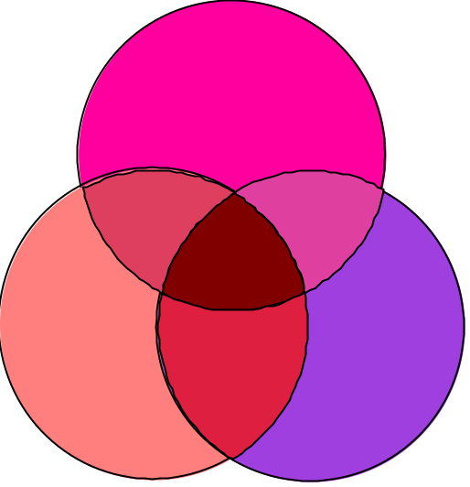
Intersections versus Unions
Intersections - “Both/And”
  The intersection of A and B is the set of all events for which both A and B occur.
Unions - “Either/Or”
  The union of A or B is the set of all events for with either A or B occur.
        © 2011 Cengage Learning.
        All Rights Reserved. May not be scanned, copied, duplicated, or posted to a publicly accessible website, in whole or in part.

Slide 8
Working with Unions and Intersections
The general rule of addition:
P(A or B) = P(A) + P(B) – P(A and B)
is always true.
When events A and B are mutually exclusive, the last term in the rule, P(A and B), will be zero by definition.
        © 2011 Cengage Learning.
        All Rights Reserved. May not be scanned, copied, duplicated, or posted to a publicly accessible website, in whole or in part.

Slide 9
Three Kinds of Probabilities
Marginal or simple probability
  The probability that a single event will occur.
  The typical expression is P(A).
Joint or compound probability
  The probability that two or more events occur. The typical expression is P(A and B).
Conditional probability
  The probability that an event, A, occurs given that another event, B, has already happened.
  The typical expression is P(A|B).
        © 2011 Cengage Learning.
        All Rights Reserved. May not be scanned, copied, duplicated, or posted to a publicly accessible website, in whole or in part.

Slide 10
The Contingency Table:
An Example
Problem 5.15: The following table represents gas well completions during 1986 in North and South America.
D D’
Dry Not Dry Totals
N North America 14,131 31,575 45,706
N’ South America 404 2,563 2,967
Totals 14,535 34,138 48,673
        © 2011 Cengage Learning.
        All Rights Reserved. May not be scanned, copied, duplicated, or posted to a publicly accessible website, in whole or in part.

Slide 11
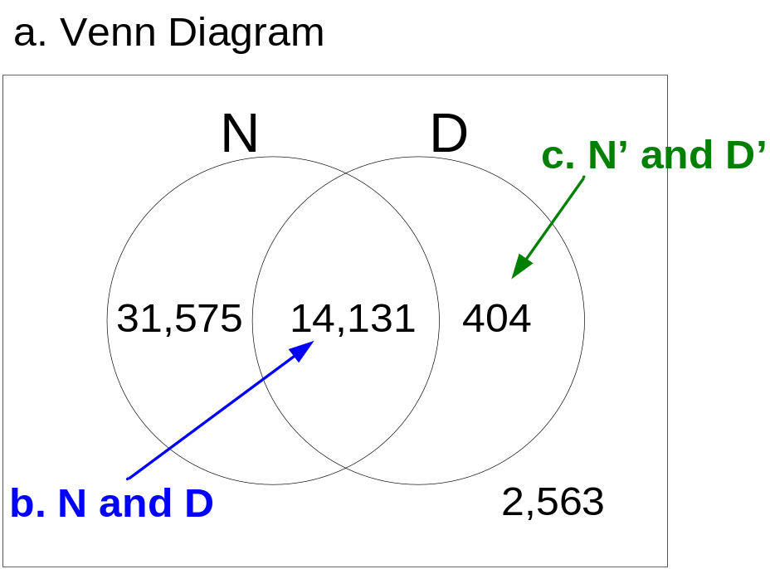
Example, Problem 5.15 a. – c.
D D’
Dry Not Dry Totals
N North America 14,131 31,575 45,706
N’ South America 404 2,563 2,967
Totals 14,535 34,138 48,673
        © 2011 Cengage Learning.
        All Rights Reserved. May not be scanned, copied, duplicated, or posted to a publicly accessible website, in whole or in part.

Slide 12
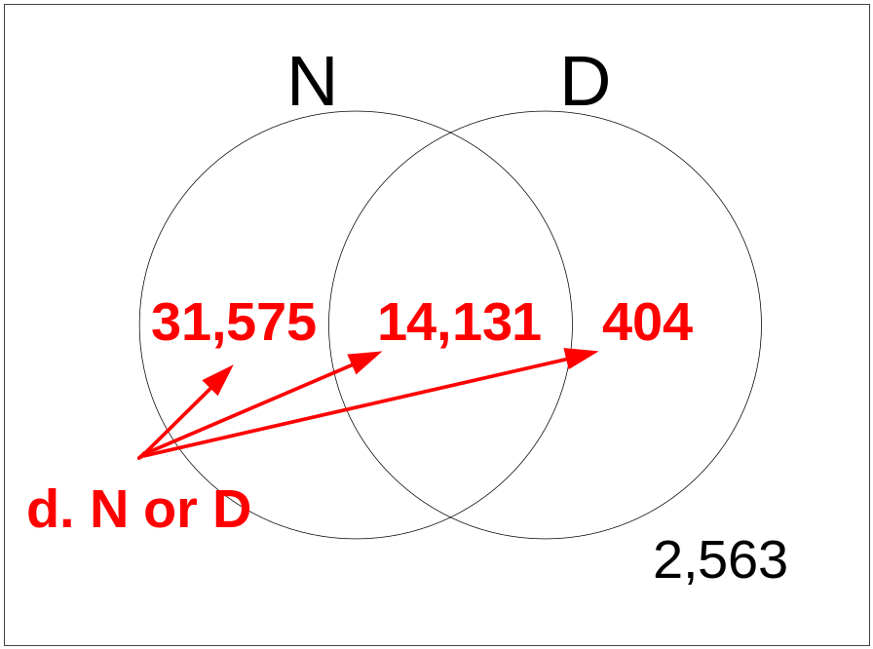
Example, Problem 5.15 d.
D D’
Dry Not Dry Totals
N North America 14,131 31,575 45,706
N’ South America 404 2,563 2,967
Totals 14,535 34,138 48,673
        © 2011 Cengage Learning.
        All Rights Reserved. May not be scanned, copied, duplicated, or posted to a publicly accessible website, in whole or in part.

Slide 13
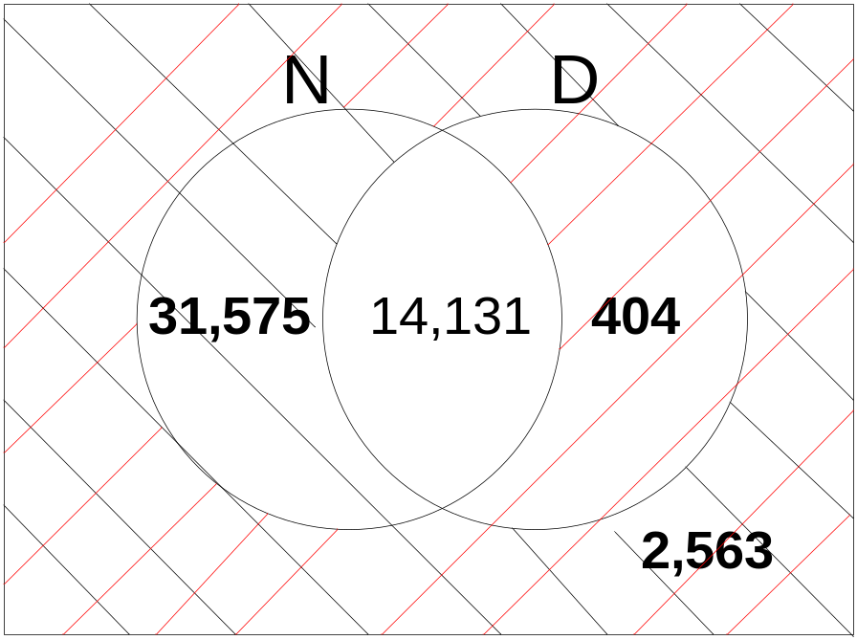
Example, Problem 5.15 e.
D D’
Dry Not Dry Totals
N North America 14,131 31,575 45,706
N’ South America 404 2,563 2,967
Totals 14,535 34,138 48,673
Ans:
N’ or D’ = (N and D)’
        © 2011 Cengage Learning.
        All Rights Reserved. May not be scanned, copied, duplicated, or posted to a publicly accessible website, in whole or in part.

Slide 14
Investigating Problem 5.15
D D’
Dry Not Dry Totals
N North America 14,131 31,575 45,706
N’ South America 404 2,563 2,967
Totals 14,535 34,138 48,673
1. What is P(N)?  1. Simple probability: 45,706/48,673
2. What is P(D’ and N) ?  2. Joint probability: 31,575/48,673
3. What is P(D’ or N) ?  3. Equivalent solutions:
  3a. (34,138 + 45,706 – 31,575)/48,673 OR ...
  3b. (31,575 + 2,563 + 14,131)/48,673 OR ...
  3c. (34,138 + 14,131)/48,673 OR ...
  3d. (48,673 – 2,563)/48,673
        © 2011 Cengage Learning.
        All Rights Reserved. May not be scanned, copied, duplicated, or posted to a publicly accessible website, in whole or in part.

Slide 15
Simple and Joint Probabilities Share a Denominator
Note that, when probabilities are calculated from empirical data, both simple and joint probabilities use the entire sample as a denominator.
Watch what happens with conditional probabilities.
        © 2011 Cengage Learning.
        All Rights Reserved. May not be scanned, copied, duplicated, or posted to a publicly accessible website, in whole or in part.

Slide 16
Investigating Problem 5.15
D D’
Dry Not Dry Totals
N North America 14,131 31,575 45,706
N’ South America 404 2,563 2,967
Totals 14,535 34,138 48,673
What is P(N|D)?  Conditional probability: 14,131/14,535
What is P(D|N)?  Conditional probability: 14,131/45,706
What is P(D’|N)?  Conditional probability: 31,575/45,706
What is P(N|D’)?  Conditional probability: 31,575/34,138
Note that conditional probabilities are the ONLY ones whose denominators are NOT the total sample.
        © 2011 Cengage Learning.
        All Rights Reserved. May not be scanned, copied, duplicated, or posted to a publicly accessible website, in whole or in part.

Slide 17
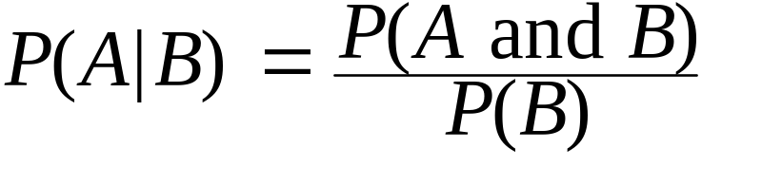
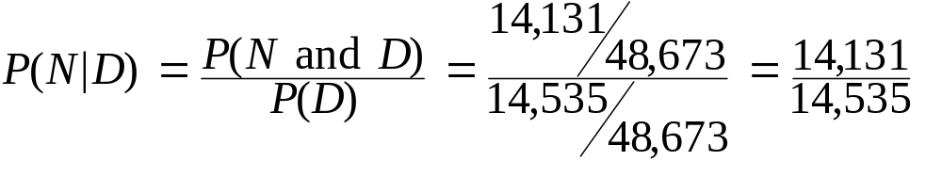
Conditional Probability -
A Definition
Conditional probability of event A, given that event B has occurred:
where P(B) > 0
So, from our prior example,
        © 2011 Cengage Learning.
        All Rights Reserved. May not be scanned, copied, duplicated, or posted to a publicly accessible website, in whole or in part.

Slide 18
Independent Events
Events are independent when the occurrence of one event does not change the probability that another event will occur.
  If A and B are independent, P(A|B) = P(A) because the occurrence of event B does not change the probability that A will occur.
  If A and B are independent, then
  P(A and B) = P(A) • P(B)
        © 2011 Cengage Learning.
        All Rights Reserved. May not be scanned, copied, duplicated, or posted to a publicly accessible website, in whole or in part.

Slide 19
When Events Are Dependent
Events are dependent when the occurrence of one event does change the probability that another event will occur.
  If A and B are dependent, P(A|B) ≠ P(A) because the occurrence of event B does change the probability that A will occur.
  If A and B are dependent, then
  P(A and B) = P(A) • P(B|A)
        © 2011 Cengage Learning.
        All Rights Reserved. May not be scanned, copied, duplicated, or posted to a publicly accessible website, in whole or in part.

Slide 20
The Probability Tree:
Problem 5.15
Location first
D 14,131/45,706
N
14,131/48,673
45,706/48,673
D’ 31,575/45,706
31,575/48,673
D 404/2,967
404/48,673
N’
2,967/48,673
D’ 2,563/2,967
2,563/48,673
        © 2011 Cengage Learning.
        All Rights Reserved. May not be scanned, copied, duplicated, or posted to a publicly accessible website, in whole or in part.

Slide 21
The Probability Tree:
Problem 5.15
Well condition first
N 14,131/14,535
D
14,131/48,673
14,535/48,673
N’ 404/14,535
404/48,673
N 31,575/ 34,138
31,575 /48,673
D’
34,138/48,673
N’ 2,563/ 34,138
2,563/48,673
        © 2011 Cengage Learning.
        All Rights Reserved. May not be scanned, copied, duplicated, or posted to a publicly accessible website, in whole or in part.

Slide 22
What’s the Probability of a Dry Well? It Depends....
Does knowing where the well was drilled change your estimate of the chances it was dry?
P(D) = 14,535/48,673 = 0.2986
P(D|N’) = 404/2,967 = 0.1362
P(D|N) = 14,131/45,706 = 0.3092
Yes. If it didn’t matter where the well was drilled, the simple probability of being dry [P(D)] would equal the conditional probabilities of being dry given it was located in South America [P(D|N’)] or in North America [P(D|N)]. Since they do not equal each other, the probability the well is dry is dependent upon its location.
        © 2011 Cengage Learning.
        All Rights Reserved. May not be scanned, copied, duplicated, or posted to a publicly accessible website, in whole or in part.

Slide 23
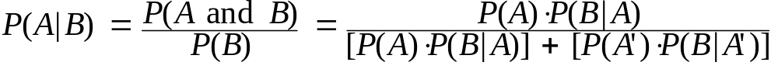
Bayes’ Theorem for the
Revision of Probability
In the 1700s, Thomas Bayes developed a way to revise the probability that a first event occurred from information obtained from a second event.
Bayes’ Theorem: For two events A and B
        © 2011 Cengage Learning.
        All Rights Reserved. May not be scanned, copied, duplicated, or posted to a publicly accessible website, in whole or in part.

Slide 24
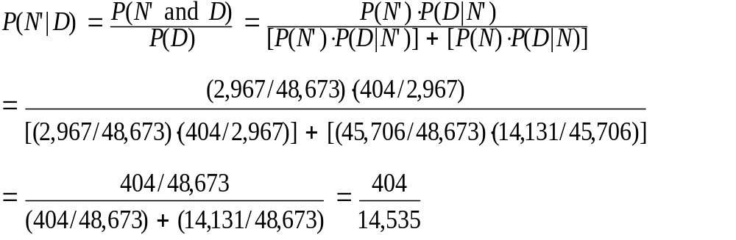
Revising Probability -
Problem 5.15
Can we compute P(N’|D) from P(D|N’)?
Using Bayes’ Theorem:
        © 2011 Cengage Learning.
        All Rights Reserved. May not be scanned, copied, duplicated, or posted to a publicly accessible website, in whole or in part.

Slide 25
Counting
Multiplication rule of counting: If there are m ways a first event can occur and n ways a second event can occur, the total number of ways the two events can occur is given by m x n.
Factorial rule of counting: The number of ways n objects can be arranged in order.
n! = n x (n – 1) x (n – 2) x ... x 1
Note that 1! = 0! = 1 by definition.
        © 2011 Cengage Learning.
        All Rights Reserved. May not be scanned, copied, duplicated, or posted to a publicly accessible website, in whole or in part.

Slide 26
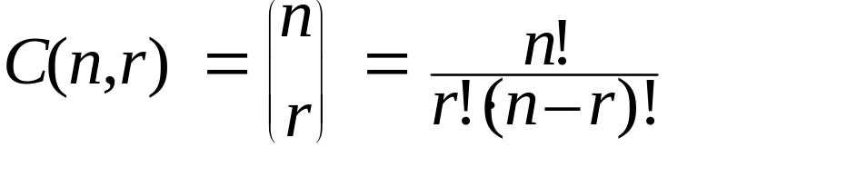
More Counting
Permutations: The number of different ways n objects can be arranged taken r at a time. Order is important.
Combinations: The number of ways n objects can be arranged taken r at a time. Order is not important.
n
P
!
(
n
,
r
)
=
(
n
–
r
)!
        © 2011 Cengage Learning.
        All Rights Reserved. May not be scanned, copied, duplicated, or posted to a publicly accessible website, in whole or in part.

